Slide 1
Cryptography Basics
Henry Wise Wood Math and Computer Science Club
December 12, 2011

Slide 2
Why do I need Cryptography?
Confidentiality Ensuring that only intended recipients can read a message
Authentication / Non-repudiation Proving one’s identity and preventing a sender from denying that he/she sent the message
Integrity Verifying that a message has not been damaged in transmission

Slide 3
Hash functions
A one-way function that takes an arbitrary amount of data and produces a fixed-length output, called a hash/digest
A 16-byte hash has 128 bits, so there are 2¹²⁸ ≈ 3.4 × 10³⁸ possible hashes
0 to ∞
bytes of data
Cryptographic hash function
16 byte hash

Slide 4
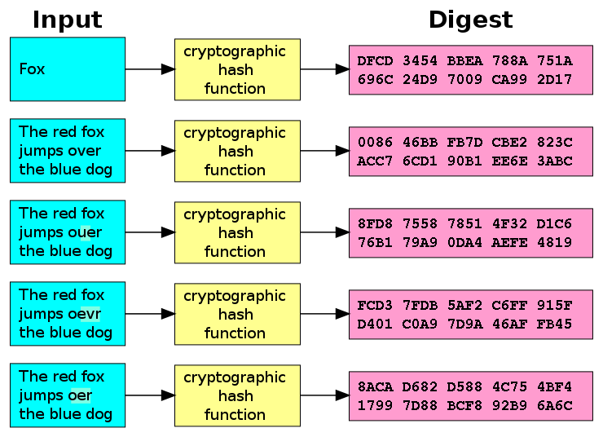

Slide 5
Using a hash function
Bob wants to send data to Suzy, and he wants to make sure that she gets the correct data
So, he first generates a hash of the data and sends both the data and hash to Suzy
Upon receipt of the data, Suzy hashes the data and checks if the hash she generates matches the hash Bob sends
If it matches, the data is intact. Otherwise, Suzy knows that the data has been damaged in transit and must ask Bob to send it again
Bob’s music collection
Hash of data

Slide 6
Summary: Why do I need a hash function?
Confidentiality Ensuring that only intended recipients can read a message
Authentication / Non-repudiation Proving one’s identity and preventing a sender from denying that he/she sent the message
Integrity Verifying that a message has not been damaged in transmission

Slide 7
Symmetric encryption
The same secret key is used for both encryption and decryption
Key sized is fixed – common sizes are 16 bytes (128 bits) and 32 bytes (256 bits)
Encryption
Decryption
Secret key (16 bytes)
Encryption
function
Data
+
Encrypted data
Secret key (16 bytes)
Decryption
function
Encrypted data
+
Data

Slide 8
Symmetric encryption with passwords
How do we convert a password into a fixed-length key?
Slower hash functions are more secure because they make brute-force attacks hard
The password is usually hashed multiple times to make it slower
Cryptographic hash function
16 byte hash (secret key)
PASSWORD
Data
Secret key (16 bytes)
Encrypted data
+

Slide 9
Summary: Why do I need a symmetric encryption?
Confidentiality Ensuring that only intended recipients can read a message
Authentication / Non-repudiation Proving one’s identity and preventing a sender from denying that he/she sent the message
Integrity Verifying that a message has not been damaged in transmission

Slide 10
Postal problem
Alice needs to send a secret message to Bob through the mail
Alice has never met Bob
Alice has a lockable iron box
Bob has a padlock and key
The postal service will read her message unless it is locked inside the iron box
How can Alice and Bob accomplish their goal?

Slide 11
Postal problem solution
Bob sends Alice his lock but keeps the key
Alice places her message in the iron box and locks it with Bob’s lock
Bob receives the box and unlocks it

Slide 12
Asymmetric encryption
Different keys are used for encryption and decryption.
The keys are mathematically related, but it is unfeasible to derive one key from the other
Common key sizes are 128 bytes (1024 bits), 256 bytes (2048 bits) and 512 bytes (4096 bits)
Encryption
Decryption
The encryption key is like Bob’s padlock, and the decryption key is like Bob’s key
Bob sends Alice his encryption key. Alice encrypts her message with it and sends it back to Bob. Bob decrypts the message with his decryption key.
Encryption key (128 bytes)
One-way
Data
+
Encrypted data
Decryption key (128 bytes)
One-way
Encrypted data
+
Data

Slide 13
Asymmetric encryption: practical considerations
Cipher | Speed (on 1.8 GHz Core 2 Duo) | Time to process 1GB file | Cipher name | Number of operations to crack
Symmetric encryption | 100 MB/s | 10 sec | 128-bit AES | 2¹²⁸
Symmetric decryption | 100 MB/s | 10 sec | 128-bit AES
Asymmetric encryption | 1 MB/s | 16.67 min | 3072-bit RSA | 2¹²⁸
Asymmetric decryption | 0.02 MB/s (20 KB/s) | 13.89 hrs | 3072-bit RSA
It is unfeasible to encrypt large amounts of data with asymmetric encryption
Usually, asymmetric encryption is only used to encrypt a key for symmetric encryption
Hackers can exploit this to bring down websites
Notice that key size does not indicate security level

Slide 14
Digital signatures
A digital signature proves the authenticity of a message
There are 2 keys in a digital signature scheme, a signing key and verification key
Only the signing key can be used to sign messages, and only the verification key can be used to verify messages
The signing key and verification key are mathematically related, but it is unfeasible to derive one from the other

Slide 15
Digital signatures
Hash functions + asymmetric encryption = digital signature
Signing
Only a person who has the correct encryption key will be able to produce the encrypted hash
However anyone with the decryption key will be able to decrypt the encrypted hash
By successfully decrypting the hash, this proves the identity of the signer
0 to ∞
bytes of data
Cryptographic hash function
16 byte hash
Encryption key (signing key)
Asymmetric
encryption
Encrypted hash (digital signature)
16 byte hash
+

Slide 16
Digital signatures
Signing
Verification
If the hashes match, verification is successful
0 to ∞
bytes of data
Cryptographic hash function
16 byte hash
Encryption key (signing key)
Asymmetric
encryption
Encrypted hash (digital signature)
16 byte hash
+
0 to ∞
bytes of data
Cryptographic hash function
16 byte hash
Encrypted hash (digital signature)
Decryption key (verification key)
Asymmetric
decryption
+
16 byte hash

Slide 17
Digital signatures FAQ
Signing
Q. Why not just encrypt the whole data instead of the hash?
A. 2 reasons:
It is too slow for practical use (1GB takes 16hrs)
Hashing ensures integrity while encryption alone does not
0 to ∞
bytes of data
Cryptographic hash function
16 byte hash
Encryption key (signing key)
Asymmetric
encryption
Encrypted hash (digital signature)
16 byte hash
+

Slide 18
Summary: Why do I need a digital signature?
Confidentiality Ensuring that only intended recipients can read a message
Authentication / Non-repudiation Proving one’s identity and preventing a sender from denying that he/she sent the message
Integrity Verifying that a message has not been damaged in transmission

Slide 19
Future of cryptography
New CPUs, such as the Intel Core i7, have hardware AES encryption/decryption, allowing speeds of over 1 GB/s
A quantum computer, if one could ever be built, would permanently break most asymmetric encryption and digital signature algorithms

